Slide 1

Predictive Modeling of Battery Failure
Phase 1: Statistical Foundation & Exploratory Analysis

Slide 2



Presentation Outline
01 Project Objective & Problem Statement
05 Visual Data Exploration
02 Dataset Description & Data Collection
06 Statistical Inference — Hypothesis Testing
03 Data Preprocessing & Cleaning
07 Confidence Intervals for Mean & Variance
04 Numerical Summaries
08 Discussion: Findings, Next Steps & Roadmap
Notes:
Phase 1 Requirements:
Identify the method of data collection used for the chosen dataset
Generate numerical summaries, including sample mean, variance, and standard deviation.
Construct visual data displays such as histograms, stem-and-leaf diagrams, and box plots to identify outliers and understand the distribution.
Perform hypothesis testing to determine if specific factors (e.g., temperature, pressure, or material type) significantly affect the output.
Construct confidence intervals for the mean and variance to quantify the risks in the engineering decisions
Doctor Requirements:
You should discuss the problem that you are trying to solve.
Then how would you solve it and the current progress and the next steps with discussion of expected outcomes and how would you compare your solution to similar solutions.
Also you need to show the pros and cons of your solution.

Slide 3






Project Objective & Problem Statement
CORE PROBLEM: Li-ion batteries degrade over repeated charge/discharge cycles, leading to capacity loss and eventual failure. Predicting when a battery will fail is critical for safety-critical applications like EVs, aerospace, and medical devices.
Statistical Analysis
Identify Target
Build Predictive Models
Understand the variability of battery capacity using descriptive statistics and hypothesis testing.
Determine which factors — temperature, cycle number, health class — significantly affect capacity.
Use Phase 1 insights to train ML models (Phase 2) for regression, classification, and clustering.
Notes:
objective: apply statistical analysis and machine learning techniques to a real-world lithium-ion battery degradation dataset in order to understand battery behavior over charge/discharge cycles, identify the most important variables affecting battery health, and build predictive models for battery capacity, State of Health, Remaining Useful Life, and health classification.
problem we aim to solve: The problem we aim to solve is to predict battery health and remaining useful life using cycle-level measurements such as voltage, current, temperature, load, and capacity.
Our project focuses on answering the following questions:
Which variables significantly affect battery capacity and health?
How does battery capacity change over cycles?
Can we discover hidden patterns or groups of battery cycles using clustering?
Can we predict battery capacity or remaining useful life using regression models?
Can we classify a battery cycle as Healthy or Degraded using classification models?

Slide 4

Dataset Description & Data Collection Method
NASA Li-ion Battery Dataset
Data Collection Method
Source: NASA Prognostics Center of Excellence
Retrospective Study: Data was collected in controlled lab experiments, not by us.
Batteries: 34 Li-ion cells run to end-of-life
Observations: 2,769 discharge cycles
Controlled Experiment: Cells cycled under fixed charging protocols at known temperatures.
Features: 59 cycle-level measurements
Instrumented Measurement: Voltage, current, temperature recorded at fixed intervals.
Temperature: 4°C, 24°C, 43°C, 44°C ambient
Target Variable: Capacity (Ah)
Secondary Analysis: We apply statistical inference to the pre-existing experimental data.
Labels: Healthy, Degrading
Notes:
The data collection method for this project is a retrospective secondary analysis of a controlled experimental dataset. A retrospective study means the researcher does not collect new data but analyzes data that already exists from previous experiments or records; in our case, we are using the already-published NASA battery aging dataset from Kaggle/NASA. An observational study means researchers observe a process without actively controlling or assigning experimental conditions, but this dataset is not purely observational, because the original NASA data was collected in a controlled laboratory battery prognostics testbed where lithium-ion batteries were intentionally run through charge, discharge, and electrochemical impedance spectroscopy profiles at different temperatures and load conditions until degradation/end-of-life behavior was observed. Therefore, for our project, we can say: the original dataset was collected through a controlled experimental laboratory study, while our machine learning project uses it retrospectively as an existing dataset for predictive modeling of battery degradation. The dataset is suitable because it contains real engineering measurements such as voltage, current, temperature, time, capacity, and impedance-related variables, and recent studies have used the same NASA battery aging data for battery state-of-health and remaining useful life prediction

Slide 5



Data Preprocessing & Cleaning
Drop Fully-Null Columns Removed any column where ALL values were NaN — ensuring no empty features.
2,769
59
TOTAL CYCLES
ORIGINAL FEATURES
Remove Redundant Identifiers Dropped source_file, uid, start_time as they carry no predictive value.
54
0
Remove Data Leakage Features Dropped initial_capacity and SOH_relative which derive from the target.
CLEANED FEATURES
REMAINING NULLS
Feature Engineering Review Retained cycle-level aggregates (mean, std, min, max) for sensors.

Slide 6

Numerical Summaries — Key Variables
Variable | Mean | Std Dev | Variance | Min | Max
Capacity (Ah) | 1.3265 | 0.4725 | 0.2233 | 0.000 | 2.640
State of Health (SOH) | 0.6633 | 0.2363 | 0.0558 | 0.000 | 1.320
Mean Voltage (V) | 3.4313 | 0.1985 | 0.0394 | 2.530 | 4.453
Mean Current (A) | −1.7288 | 0.7815 | 0.6107 | −3.976 | −0.029
Mean Temperature (°C) | 26.96 | 13.88 | 192.64 | 4.86 | 58.96
Cycle Number | 60.78 | 48.30 | 2333.3 | 1 | 197
KEY INSIGHT: Capacity shows high variability (std = 0.47 Ah, 36% of mean) — showing a degradation across battery life cycles within the dataset.
Notes:
The purpose of this step is to understand the basic behavior of each variable before applying machine learning. The mean tells us the typical value, while the standard deviation and variance tell us how much the values change across battery cycles. This helps us detect variability, possible outliers, important variables, and whether feature scaling is needed before modeling.
For Clustering is if we apply clustering directly, variables with larger values or larger variance may dominate the clustering result so before clustering, we need to apply standardization so all features contribute fairly - The numerical summaries show that the variables have different scales and variances, so standardization is required before clustering to prevent high-variance variables such as cycle number and temperature from dominating the clusters.
For Regression: Regression needs us to understand which variables may explain changes in the target, such as Capacity. This variation is useful because regression models learn from changes in the target. If capacity was almost constant, prediction would not be meaningful - The high variability in capacity shows that battery degradation is present in the dataset, making capacity a suitable regression target. Variables with noticeable variation, such as temperature and cycle number, may help explain and predict this degradation.
For Classification: Classification will use health_class as the target, such as Healthy or Degraded - These summaries help us identify variables that may separate Healthy and Degraded cycles. Capacity, SOH, cycle number, and temperature are expected to be important indicators for classification.
For example (classification):
Lower capacity may indicate degraded batteries.
Lower SOH may indicate worse battery health.
Higher cycle number may be related to aging.
Temperature variability may affect degradation behavior.

Slide 7
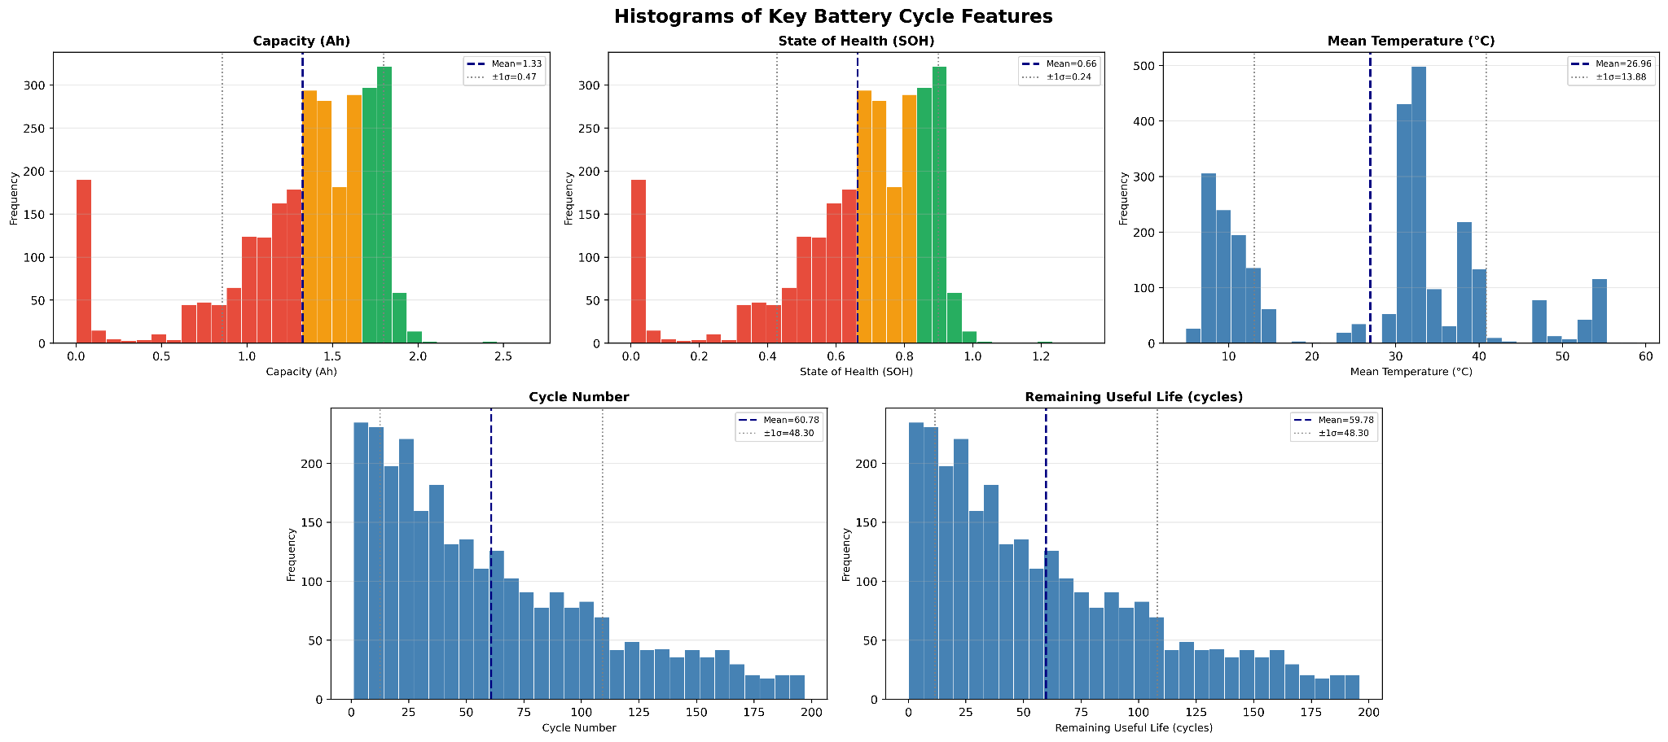
Feature Distributions - Histogram
Capacity & SOH — three distinct health clusters, Both distributions are trimodal (red, orange, green bands), clearly segmenting batteries into low, mid, and high health groups. SOH mean of 0.66 confirms the dataset spans the full degradation spectrum.
SOH — heavy aging tail A large red cluster sits below SOH = 0.4, indicating a substantial share of severely degraded cells. Capacity ranges from near-zero to 2.5 Ah, reflecting batteries from fresh to end-of-life.
Temperature — bimodal operating conditions, Mean temperature peaks near 8 °C and 28 °C (mean 26.96 ± 13.88), suggesting two distinct test environments — cold-chamber vs. ambient — contributing to degradation variance.
Cycle number & RUL — early-life dense, full lifecycle covered, Both share a right-skewed distribution (mean ≈ 60, σ ≈ 48) with most data concentrated in early cycles, yet the tail extends to 200 — ensuring the model trains on all lifecycle phases.
Notes:
purpose of histograms is to help us see whether the data is normally distributed, skewed, spread out, or contains unusual values/outliers.
Capacity histogram: shows that battery capacity is not constant; it has noticeable variation. This confirms that the dataset contains different degradation levels, so Capacity is a useful regression target (battery capacity varies clearly across cycles ).
SOH histogram: It shows that many SOH values are in the medium-to-low range. This means the dataset includes batteries at different health stages, which helps in health classification - State of Health values are spread across different health levels, including medium and low SOH values.
Temperature histogram: It shows that the batteries were tested under different temperature conditions. This is useful because temperature may affect battery degradation and can be an important feature.
Cycle Number: Cycle number is an important feature for studying battery aging and can help regression and classification models.
Remaining Useful Life: Remaining Useful Life values are not equally distributed; many cycles have lower RUL values.
From the histograms, we can see that Capacity and SOH are left-skewed with possible low-value outliers, while Cycle Number and RUL are right-skewed. Temperature appears multi-modal because the batteries were tested under different experimental temperature conditions. These observations help us decide that scaling, outlier checking, and careful train-test splitting are needed before applying machine learning models.

Slide 8
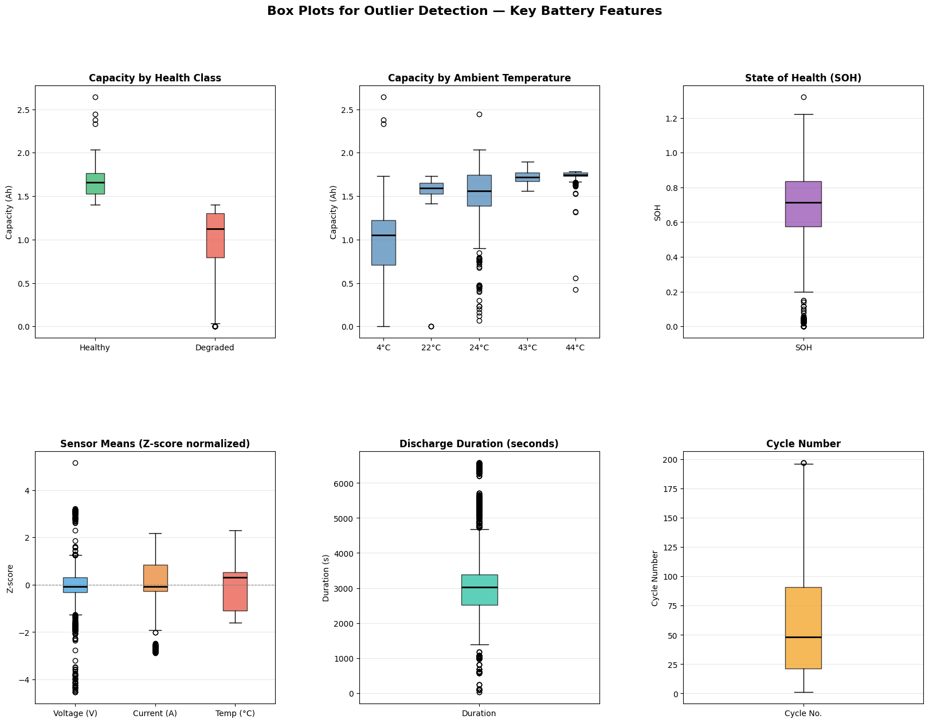

Outlier Analysis — Box Plots (Key Features)
Findings
Capacity clearly separates health classes
Healthy batteries cluster tightly around 1.65 Ah. Degraded batteries sit lower (~1.1 Ah median) but with a much wider spread, meaning degraded cells are inconsistent in behavior, not just weaker.
Low temperature significantly reduces capacity
The 4°C group shows the lowest median capacity (~1.0 Ah) and highest variability. Capacity stabilises and improves from 22°C to 44°C, confirming temperature as a key operating condition affecting battery performance.
SOH and cycle number both reveal a degradation tail. SOH bulk falls between 0.60–0.85, but 214 outliers (7.7%) sit below 0.2 — severe degradation events. Cycle number is right-skewed (median ≈ 50, max = 200), meaning data is dense in early life and thins toward end-of-life.
Discharge duration and voltage are the most outlier-prone features. Discharge duration has 651 outliers (23.5%) — the highest of any feature — with values ranging from near 0 to 6500s. Voltage follows with 352 outliers (12.7%), far exceeding current and temperature, flagging both as preprocessing priorities.
Notes:
outliers helps us decide whether these values are real degradation/failure cases or possible measurement errors.
In this dataset, outliers are important because very low Capacity or SOH values may actually represent failed or highly degraded batteries, not wrong data.
outliers are calculated using IQR:
The steps are:
Calculate Q1 = 25th percentile
Calculate Q3 = 75th percentile
Calculate:
IQR=Q3−Q1
Any value below or above these limits is considered an outlier:
Lower Limit=Q1−1.5×IQR
Upper Limit=Q3+1.5×IQR
So, any value outside this range is marked as an outlier in the box plot.
from the charts we can see that:
Capacity: 214 outliers, about 7.7% & Very low or very high capacity cycles
SOH: 214 outliers, about 7.7% & Very degraded or unusual health values
Voltage mean: 352 outliers, about 12.7% & Possible abnormal voltage behavior
Current mean: 200 outliers, about 7.4% & Possible unusual current behavior
Temperature mean: 0 outliers & Temperature values are within expected ranges
Discharge duration: 651 outliers, about 23.5% & Large variation in cycle duration
How can we solve or handle the outliers?
For example, very low Capacity and SOH values may represent real battery failure. In this case, we should keep them, because they are important for predicting degradation.
Use scaling: For ML models, we should apply scaling, especially for: K-means clustering, SVM, ANN, Polynomial regression. A good option is RobustScaler, because it is less affected by outliers than StandardScaler
Use models that are less sensitive to outliers - Decision Trees and Random Forests are usually less affected by outliers than Linear Regression, SVM, or K-means.

Slide 9

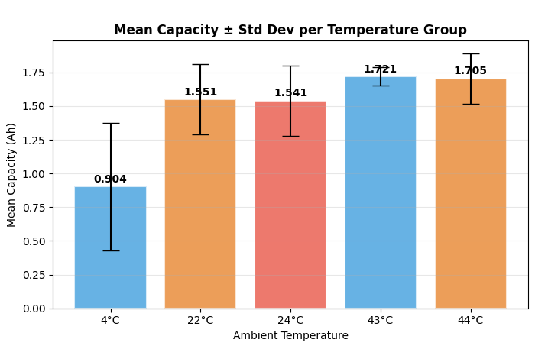



Hypothesis Test 1 — ANOVA: Temperature Effect
606.43
p < 0.001
REJECT H₀
F-STATISTIC
P-VALUE
DECISION
The ANOVA test shows a significant difference in battery capacity between temperature groups. Since p < 0.05, we reject H₀. This means that ambient temperature affects battery capacity.
Notes:
The purpose of hypothesis testing is to check whether the difference we see in the data is real and statistically significant, or if it could have happened by random chance.
so our hypothesis question is Does ambient temperature significantly affect battery capacity? → because if temperature affects capacity, then temperature should be considered an important feature later in regression, classification, and clustering.
ANOVA (Analysis of Variance): It is a statistical test used to compare the mean of one numerical variable across more than two groups.
In our case:
Numerical variable: Capacity
Groups: different ambient temperatures 4°C, 22°C, 24°C, 43°C, 44°C
So ANOVA checks whether the average capacity is the same across all temperature groups or not.
We used ANOVA because we are comparing capacity means across multiple temperature groups, not just two groups. If we had only two temperature groups, we could use a t-test But because we have more than two groups, ANOVA is the correct test.
Null hypothesis H₀: Ambient temperature has no effect on battery capacity (This means all temperature groups have the same average capacity.) & Alternative hypothesis H₁: Ambient temperature significantly affects battery capacity (This means at least one temperature group has a different average capacity.)
ANOVA compares two types of variation:
1. Between-group variation
This measures how different the mean capacity is between temperature groups.
Example: Is the mean capacity at 4°C different from 22°C, 43°C, or 44°C?
2. Within-group variation
This measures how much capacity values vary inside the same temperature group.
Then ANOVA calculates the F-statistic:
F= Variation within groups / Variation between groups​
If the F-value is large, it means the difference between groups is large compared to the variation inside each group.
The result showed a very large F-statistic and a p-value below 0.05, so we rejected the null hypothesis and concluded that ambient temperature significantly affects battery capacity (Ambient temperature has a statistically significant effect on battery capacity). This test tells us that temperature is not just a random variable in the dataset. It has a real relationship with battery capacity.

Slide 10
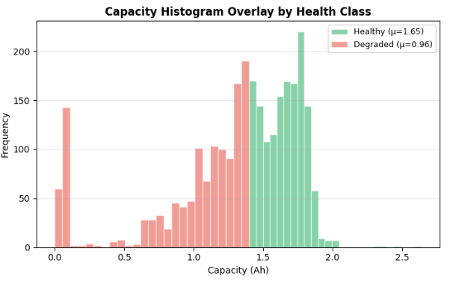
Hypothesis Test 2 — t-test: Health Class
t = 53.64
REJECT H₀
0.000
t-test
DECISION
p_value
The t-test shows a significant difference in battery capacity between healthy and degraded batteries. Since p < 0.05 (p ≈ 0), we reject H₀. This means that health class significantly affects battery capacity, with healthy batteries averaging 1.65 Ah compared to 0.96 Ah for degraded ones.
Notes:
In this hypothesis test, we wanted to know whether a battery's health class — healthy or degraded — has a real effect on its capacity, or whether any difference we see is just random chance.
We used t-test because we have two independent groups with unequal variance — you can clearly see in the histogram that the degraded group is far more spread out than the healthy group.
The t-statistic came out at 53.64, which is extremely large. To put that in perspective, anything above 1.96 is enough to reject H₀ at the 5% significance level — we got 53. The p-value is essentially zero, meaning there is virtually no chance this difference happened randomly.
So we reject H₀ and conclude that health class is a statistically significant predictor of capacity — which also validates our decision to use health class as a feature in our model."

Slide 11
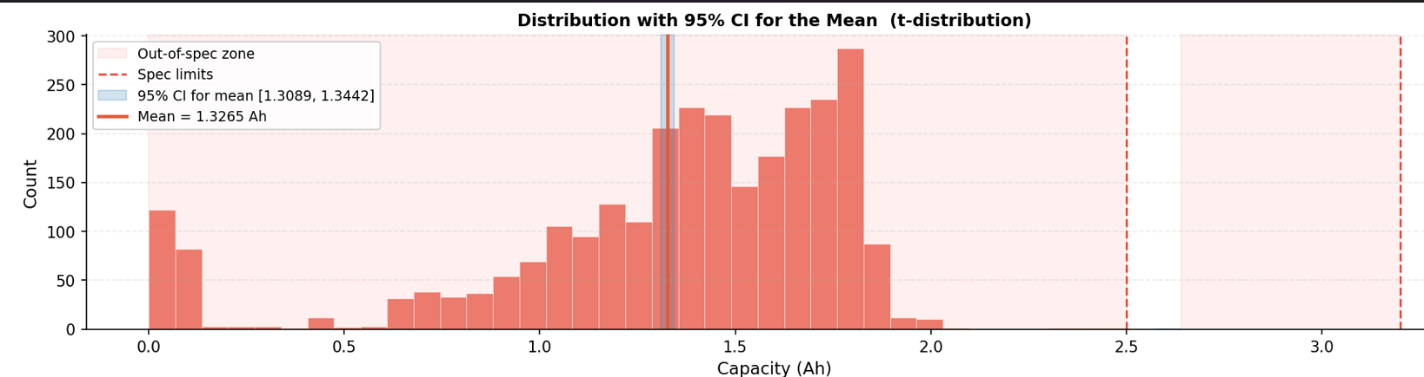
Mean & Variance Confidence Intervals
The mean Capacity is 1.3265 Ah, with a tight 95% CI of [1.3089, 1.3442], indicating a well-estimated and statistically stable central tendency across all battery cycles.
Capacity shows relatively low variance as a target variable, making it a stable and predictable output for regression. However, the presence of low-capacity outliers near 0 Ah signals degraded batteries that the model must account for.
Notes:
The purpose of a confidence interval is to estimate the range where the true average value of a battery variable is likely to fall.

Slide 12
Expected Outcomes & Literature Comparison
Approach | Task | Models | Reported Acc.
ML Comparative Review [1] | Regression - SOH estimation | SVR, Random Forest, CNN, LSTM | LSTM: R²=0.980· SVR: weakest performer
Battery-Insight-PSO [2] | Regression - RUL & SOH estimation | CEEMDAN + SVR + SSA-LSTM | R²>0.96
Deep Learning Study [3] | Regression - SOH estimation | MLP, GRU, LSTM, TCN | MLP best: R²=0.9955, GRU & LSTM slower with no accuracy gain
Our Approach | Regression Classification Clustering | EDA + Statistics + PCA + Clustering + Regression + Classification | Expected strong prediction with more complete and interpretable analysis
Notes:
prior work focused on building a regression model only. in our work we will implement:
PCA for dimensionality reduction
K-means clustering
Regression to predict Capacity – based on EDA Analysis (using Multiple Linear Regression or Polynomial Regression)
Classification we will predict health_class (using SVM vs Decision Tree vs ANN)

Slide 13




Phase 2 Preview
Clustering
Classification
K-Means (k=3) + DBSCAN
SVM with RBF kernel / ANN
Find hidden battery groups without labels.
Predict health_class.
PCA
Regression
Evaluation
REDUCTION
ANN (MLP)
TRADEOFFS
Reduce 54 features.
Predict continuous capacity.
Compare models on precision, recall, and bias.
Notes:
Feature Reduction: PCA - You have 54 features after cleaning — many are correlated (e.g., voltage_mean and voltage_last). PCA reduces them to the top components explaining ≥80% variance, removing noise before feeding into ML models
Regression Models: Linear Regression, Polynomial Regression, ANN (MLP)
Classification Models: Fisher's LDA, Perceptron, Logistic Regression, Naive Bayes, SVM, KNN, Decision Tree
Clustering Models: K-Means, Hierarchical Clustering, DBSCAN , Fuzzy C-Means

Slide 14

Thank You
Questions & Discussion

